Slide 1

Beets
Testing Results
Group 3:
Shun Mok Bhark David Wilson
Jenny Zhen Christopher Norman
Eric Caron Christopher Ketant
Notes:
Eric

Slide 2
Agenda
Project Description
Test Plan
Tools Used
Tests
Impressions
Recommendations
Notes:
Eric

Slide 3
Project Description
"the music geek's media organizer"
Open-source project started by Adrian Sampson in 2012
Music collection organizer
Metadata of the music track
Designed for experienced computer users
Command line operated
Written in Python
Cross-platform compatible
Notes:
Eric

Slide 4
Test Plan
Acceptance Testing
Load & Stress Testing
Compatibility Testing
Unit Testing
Mutation & Coverage Testing
Code Inspections
Scope
Tested core functionality
Did not test plugin functionality
Did not test MusicBrainz functionality
Notes:
Eric

Slide 5
Tools Used
FreeBugBase
Recorded bugs that were found
Organized by severity and priority
Virtual Machines
Mac OS X
Windows
Linux
Python
Version 2.7
coverage.py
unittest
nose
Notes:
Eric

Slide 6
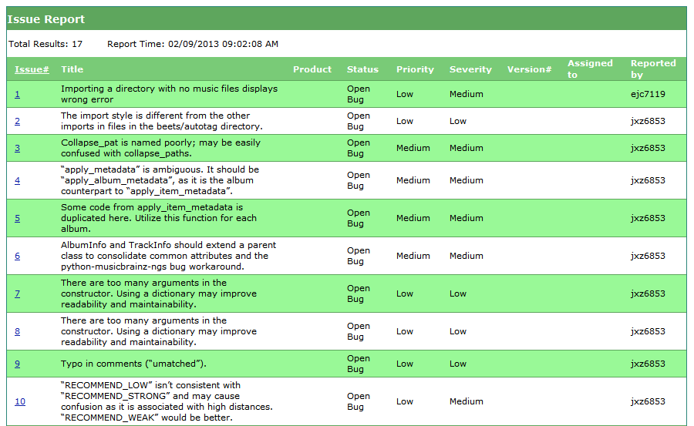
FreeBugBase
Notes:
Eric

Slide 7
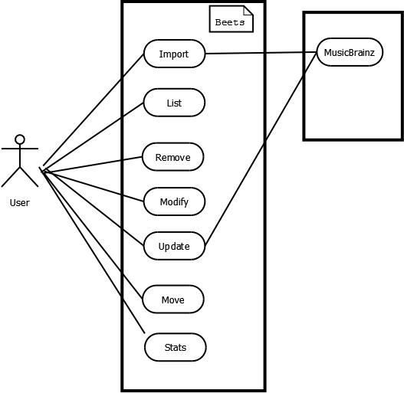
Acceptance Testing
Notes:
Chris Ketant

Slide 8
Acceptance Testing
ID: | 3
Title: | Remove
Description: | Remove the item from library
Primary Actor: | User
Preconditions: | Music files must be present in the directory from which you are importing from
Postconditions: | Meta-data for each album, track, etc. is removed from metadata library and/or from disk
Main Success Scenario: | 1. Run beet remove <option> <query> 2. If match found, confirmation message is output, “Really remove <number of items> from the library (y/n)?”
Extensions: | · OPTIONS o A – query only albums o D – deletes files from disk
Frequency of Use: | Medium
Notes:
Chris Ketant

Slide 9
Acceptance Testing
No formal requirements documentation.
Acceptance tests were manually compiled.
The total possible number of Acceptance test is unrealistic, solution is equivalence partition.
29 Tests
Results:
Pass - 35
Fail - 4
Mainly due to ambiguity in requirements and inconsistency.
Notes:
Chris Ketant

Slide 10
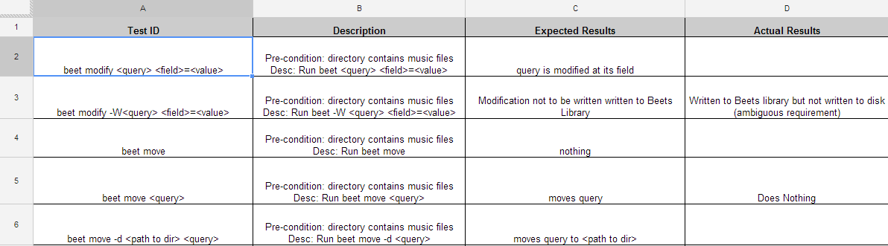
Acceptance Testing
Notes:
Chris Ketant

Slide 11
Load & Stress Testing
Load Testing
Given the time frame, we could not isolate all present variables for a viable testing strategy.
Stress Testing
Tested on VM with 32MB of RAM.
Heavily optimized Debian 6 OS.
Bare OS consumed 2MB of RAM.
Complete installation consumed 7MB of RAM.
Runs fine on the VM.
Notes:
Shun

Slide 12
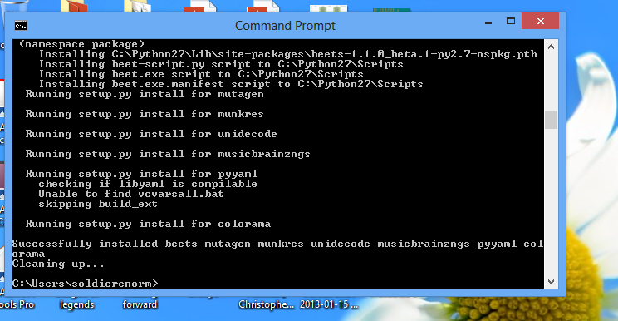
Compatibility Testing
Testing was conducted on the Mac OS X, Windows, and Linux environments.
Beets found to be compatible with all those operating systems tested.
Notes:
Chris N.

Slide 13
Mutation & Coverage Testing
PyMuTester failed.
70% coverage initially.
Active development maintained 70%.
Added unit tests to 71%.
Notes:
David

Slide 14

Unit Testing
Concentrated on the UI
UI Command Class
Initial Coverage was 53% increased to 56%
Various Artists bug
Updated Coverage
Notes:
Developer stated UI needed lots of testing.
Shun / David

Slide 15
Code Inspections
Code inspections were conducted for 4 classes in the "beets/autotag" directory for one of Beets' features.
There were 15 bugs found, ranging from a severity of low to high.
These bugs include typos in the comments, logic errors, and import of the entire "beets/" directory.
Notes:
Jenny Zhen

Slide 16
Impressions
Actively being worked on
Good job keeping on testing
Confident in the product
Small user base
Only for expert computer users
Code was well written
Commented thoroughly
Notes:
Jenny Zhen

Slide 17
Recommendations
Create a more user friendly installation.
Add more code coverage in unit tests.
Especially for user interface commands.
Create a formal requirements document.
Conduct formal code reviews.
Notes:
Chris Ketant

Slide 18
Questions?

